Slide 1

Autonomous EKF-SLAM Navigation System
Probabilistic State Estimation & Navigation for Differential Drive Robots

Slide 2

Project Overview & Objectives
1
Implement EKF-SLAM
Complete navigation pipeline from scratch.
2
Autonomous Waypoint Navigation
Develop a system for goal-oriented movement.
3
Reactive Obstacle Avoidance
Ensure safe navigation in dynamic environments.
4
Real-time Visualization
Create an intuitive dashboard for monitoring.

Slide 3
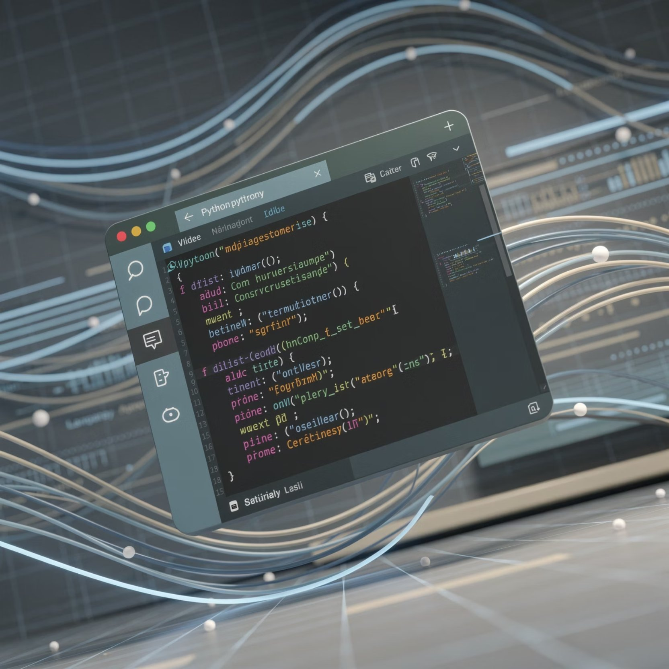
Technical Foundation
Technical Stack
Python
PyGame
NumPy
Simulation Specifications
World Size: 10×8m
Frame Rate: 60 FPS
Landmarks: 5 static objects: A:0,0 B:10,0 C:4,3 D: E
Goal Points: {(2,2),(8,4),(5,7)}

Slide 4
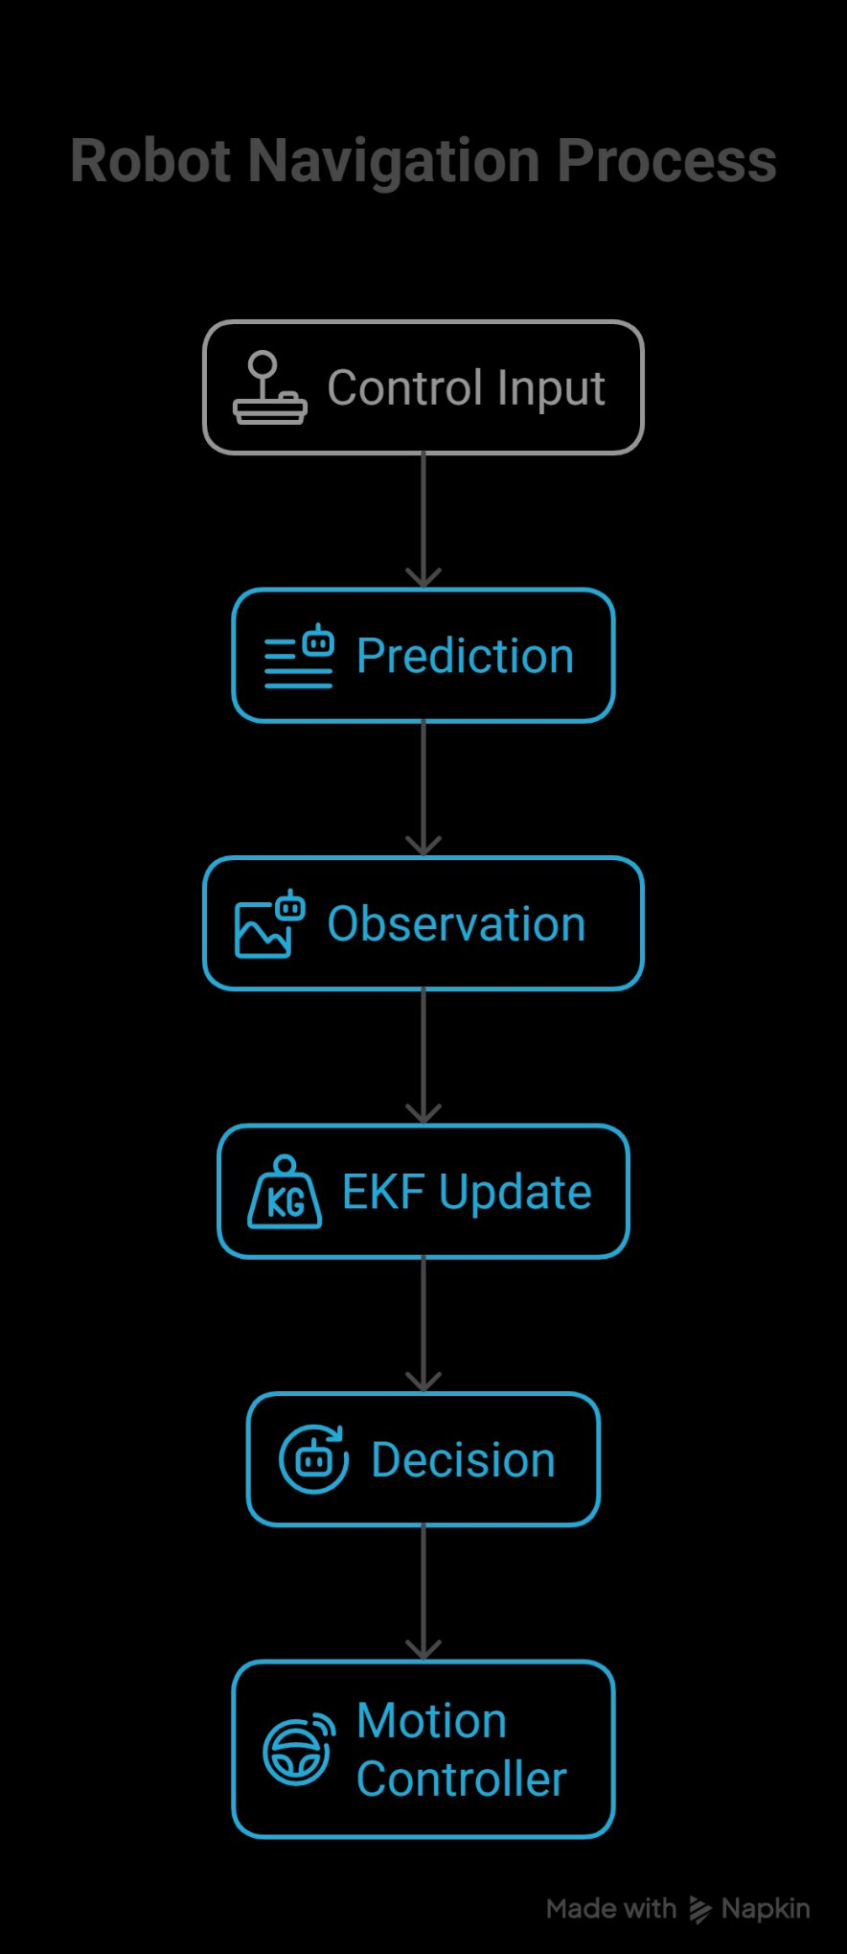





System Architecture: Real-time Processing Pipeline
Control Input
Robot receives velocity commands ($v, \omega$).
Prediction
Guess robot movement based on wheel encoders (adds uncertainty).
Observation
Robot detects landmarks using Range & Bearing.
EKF Update
Compare predicted vs. observed landmark locations to correct position.
Decision
Motion Controller adjusts steering to reach the next goal.

Slide 5
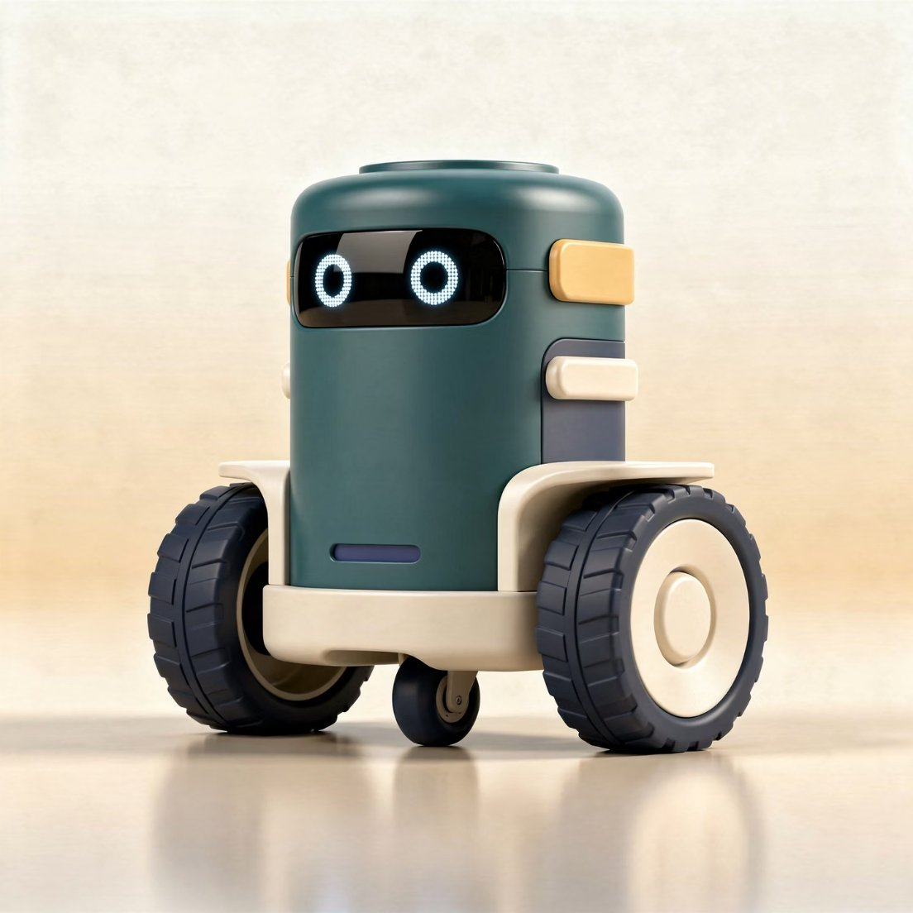
Robot Kinematics: Differential Drive
What is a Differential Drive Robot?
Moves using two independently driven wheels.
Turns by changing wheel speed, not steering.
“No steering wheel, just smart wheel speeds.”
Why Differential Drive?
Easy to model mathematically
Commonly used in indoor robots
Ideal for research and SLAM applications

Slide 6

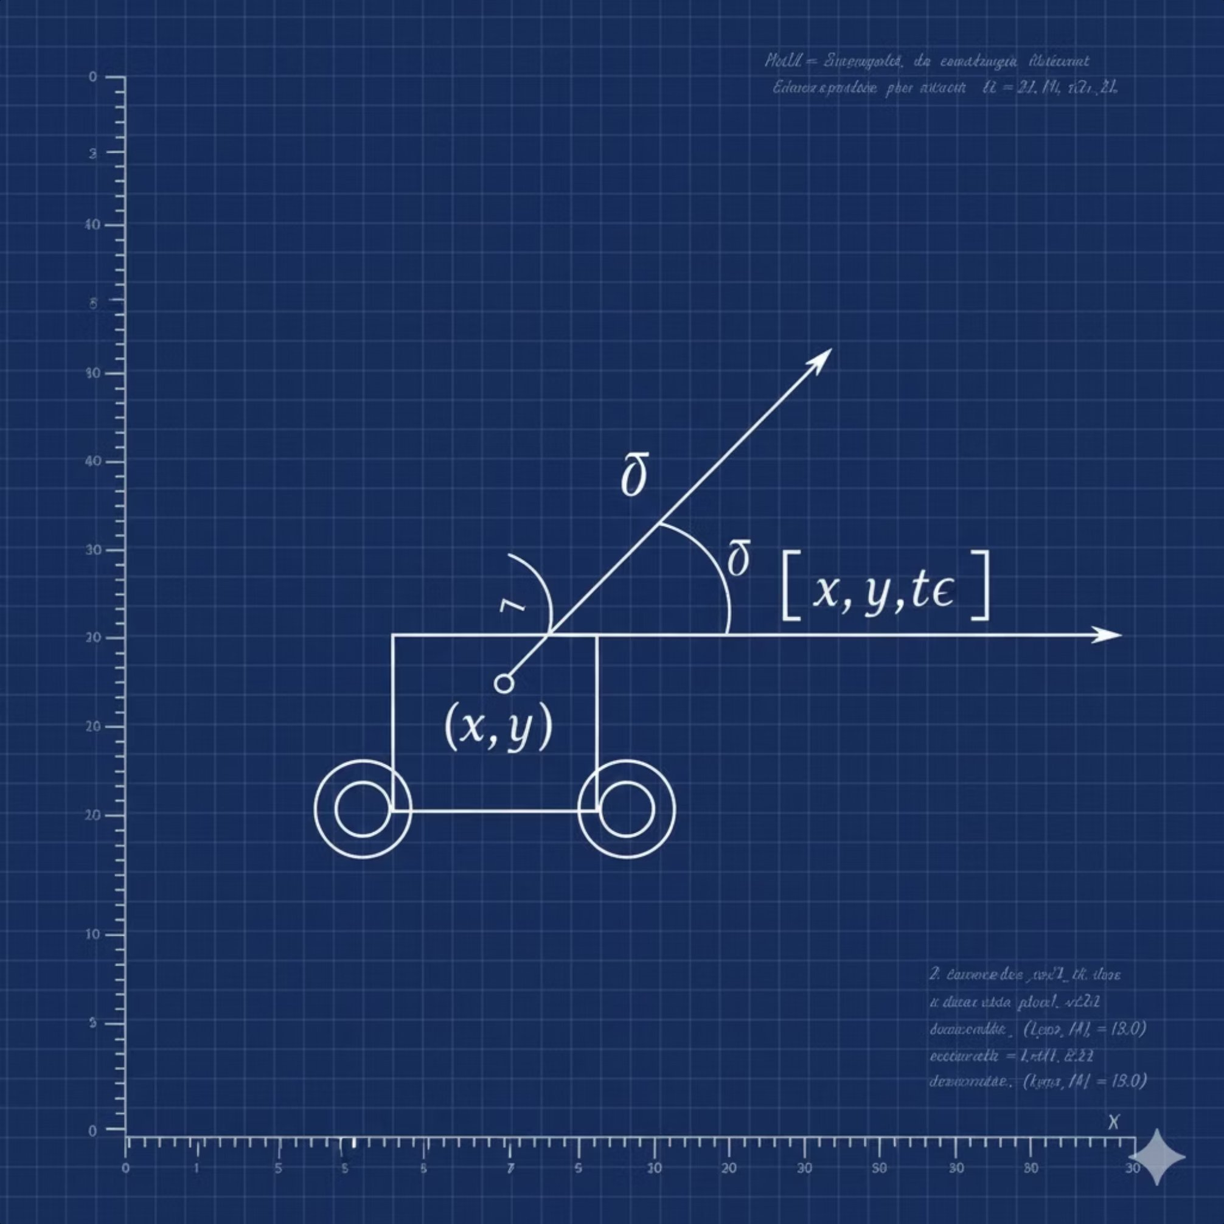
Robot Kinematics (Differential Drive)
Motion Principle
The robot’s movement depends on:
Left wheel velocity (Vl​)
Right wheel velocity (Vr​)
Distance between wheels (L)

Slide 7
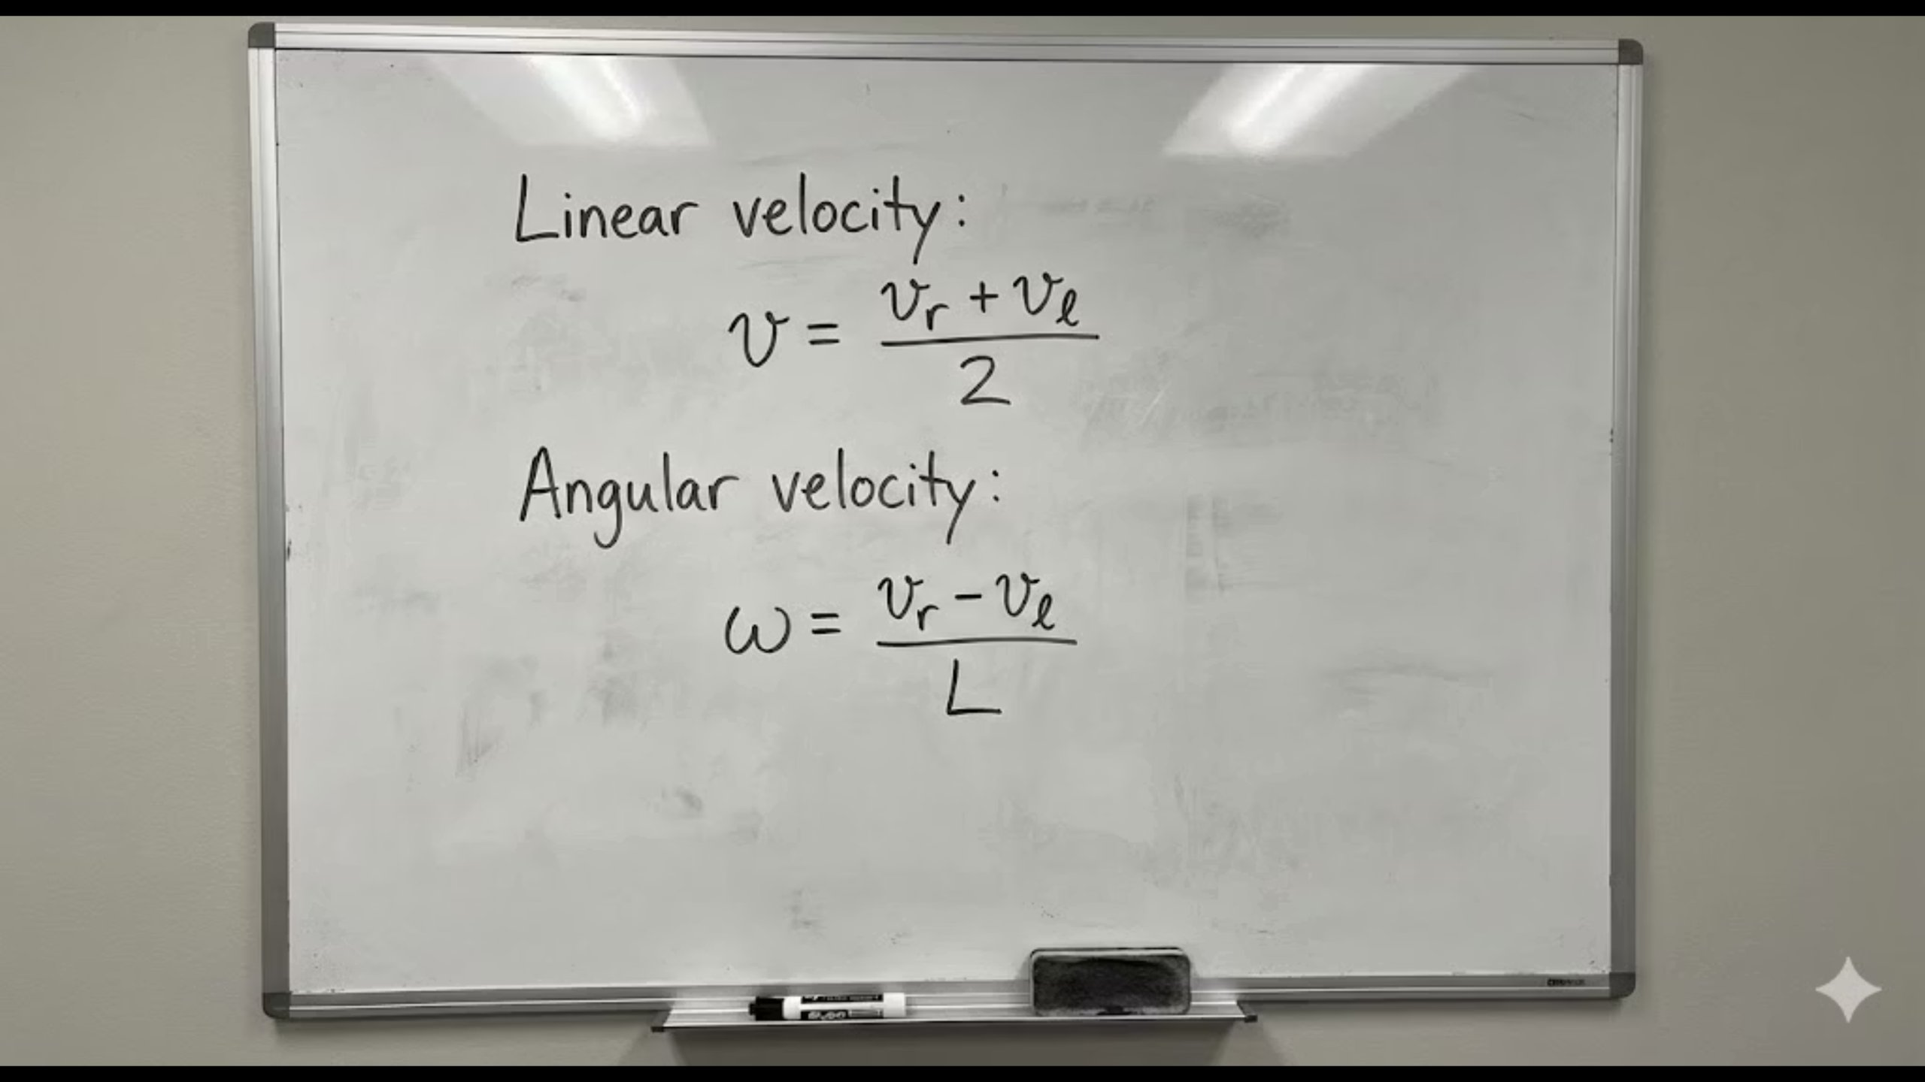

Slide 8
Motion Control (Go-to-Goal)
Control Objective
Control Strategy Used
Advantages
Move the robot autonomously from one goal point to another.
A Proportional (P) Controller based on:
Simple and effective
Smooth motion
Distance error (difference between robot and goal)
Suitable for indoor navigation
Heading error (direction mismatch)
The robot continuously adjusts its speed and direction until the goal is reached.

Slide 9
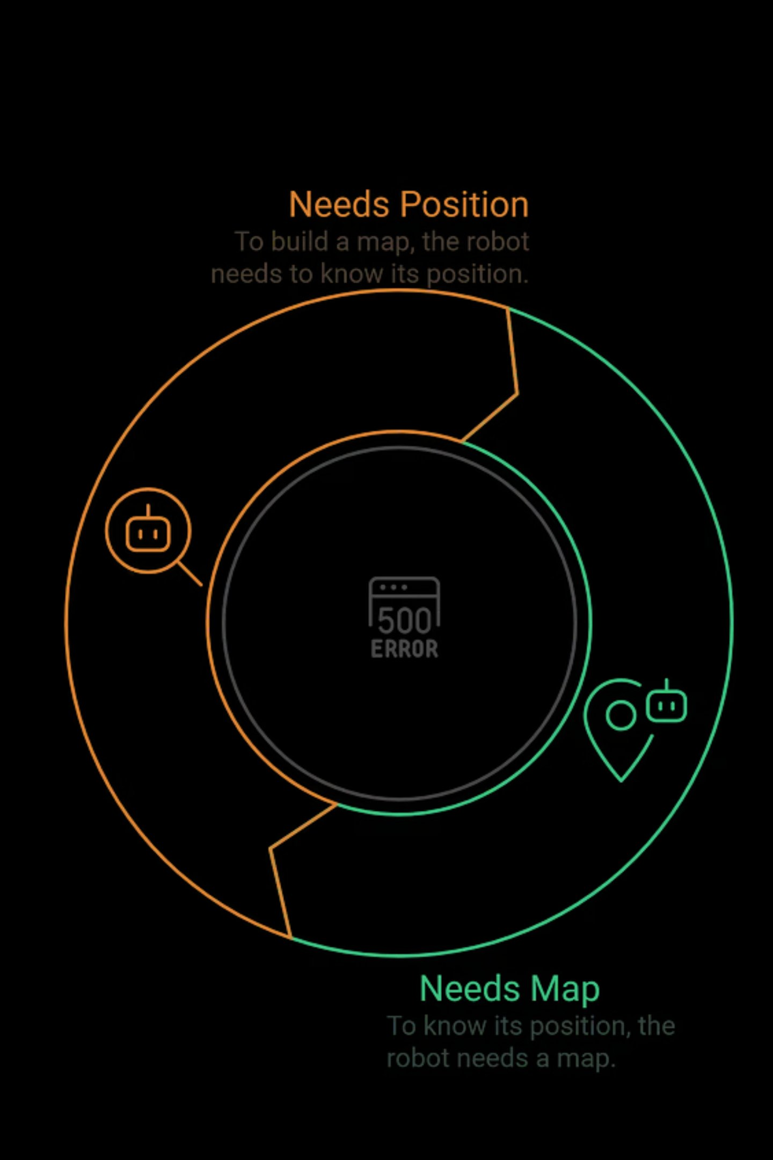
What is SLAM?
Simultaneous Localization and Mapping
SLAM enables a robot to:
Estimate its own position (localization)
Build a map of the environment (mapping)
The Core Problem
To build a map, the robot needs its position.
To know its position, the robot needs a map.
SLAM solves this chicken-and-egg problem by estimating both together.

Slide 10
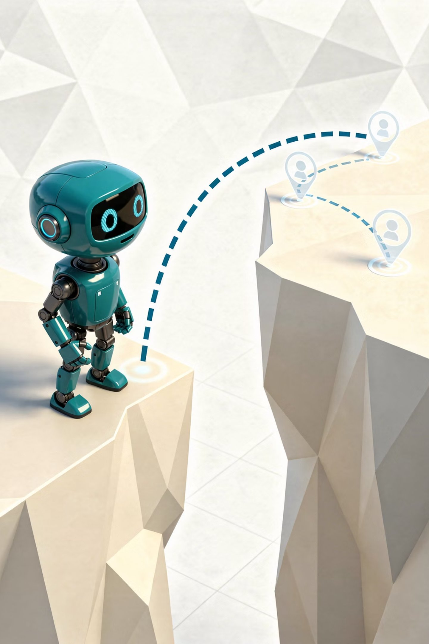
Why Do We Need SLAM?
The Simultaneous Localization and Mapping (SLAM) problem, first tackled in the 1980s, highlights a fundamental challenge in robotics.
Unknown Robot Location
Simultaneous Localization
Robot lost in unknown space.
Robot navigating known space.
Probability Based Correction
Known Robot Localization
Common Drift using Probability
Robot navigating known space

Slide 11

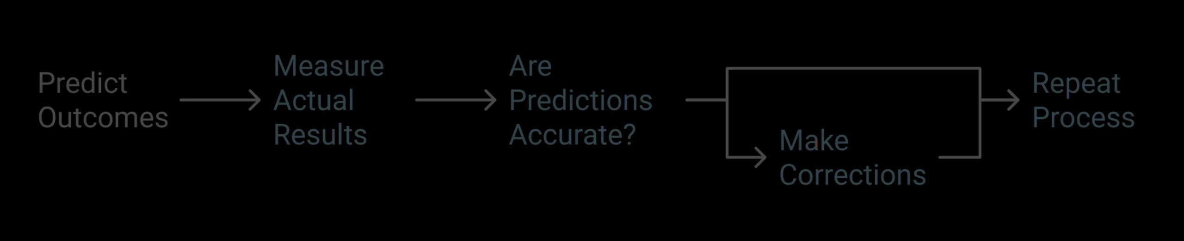
Kalman Filter
Extended Kalman Filter (EKF)
State estimation method for noisy systems
Extension of Kalman Filter
Combines prediction and sensor measurements
Used for non-linear systems
Works on linear systems
Linearizes models using Jacobians
Assumes Gaussian noise
Commonly used in robotics
Operates in a predict–correct loop
Handles motion and sensor non-linearity

Slide 12

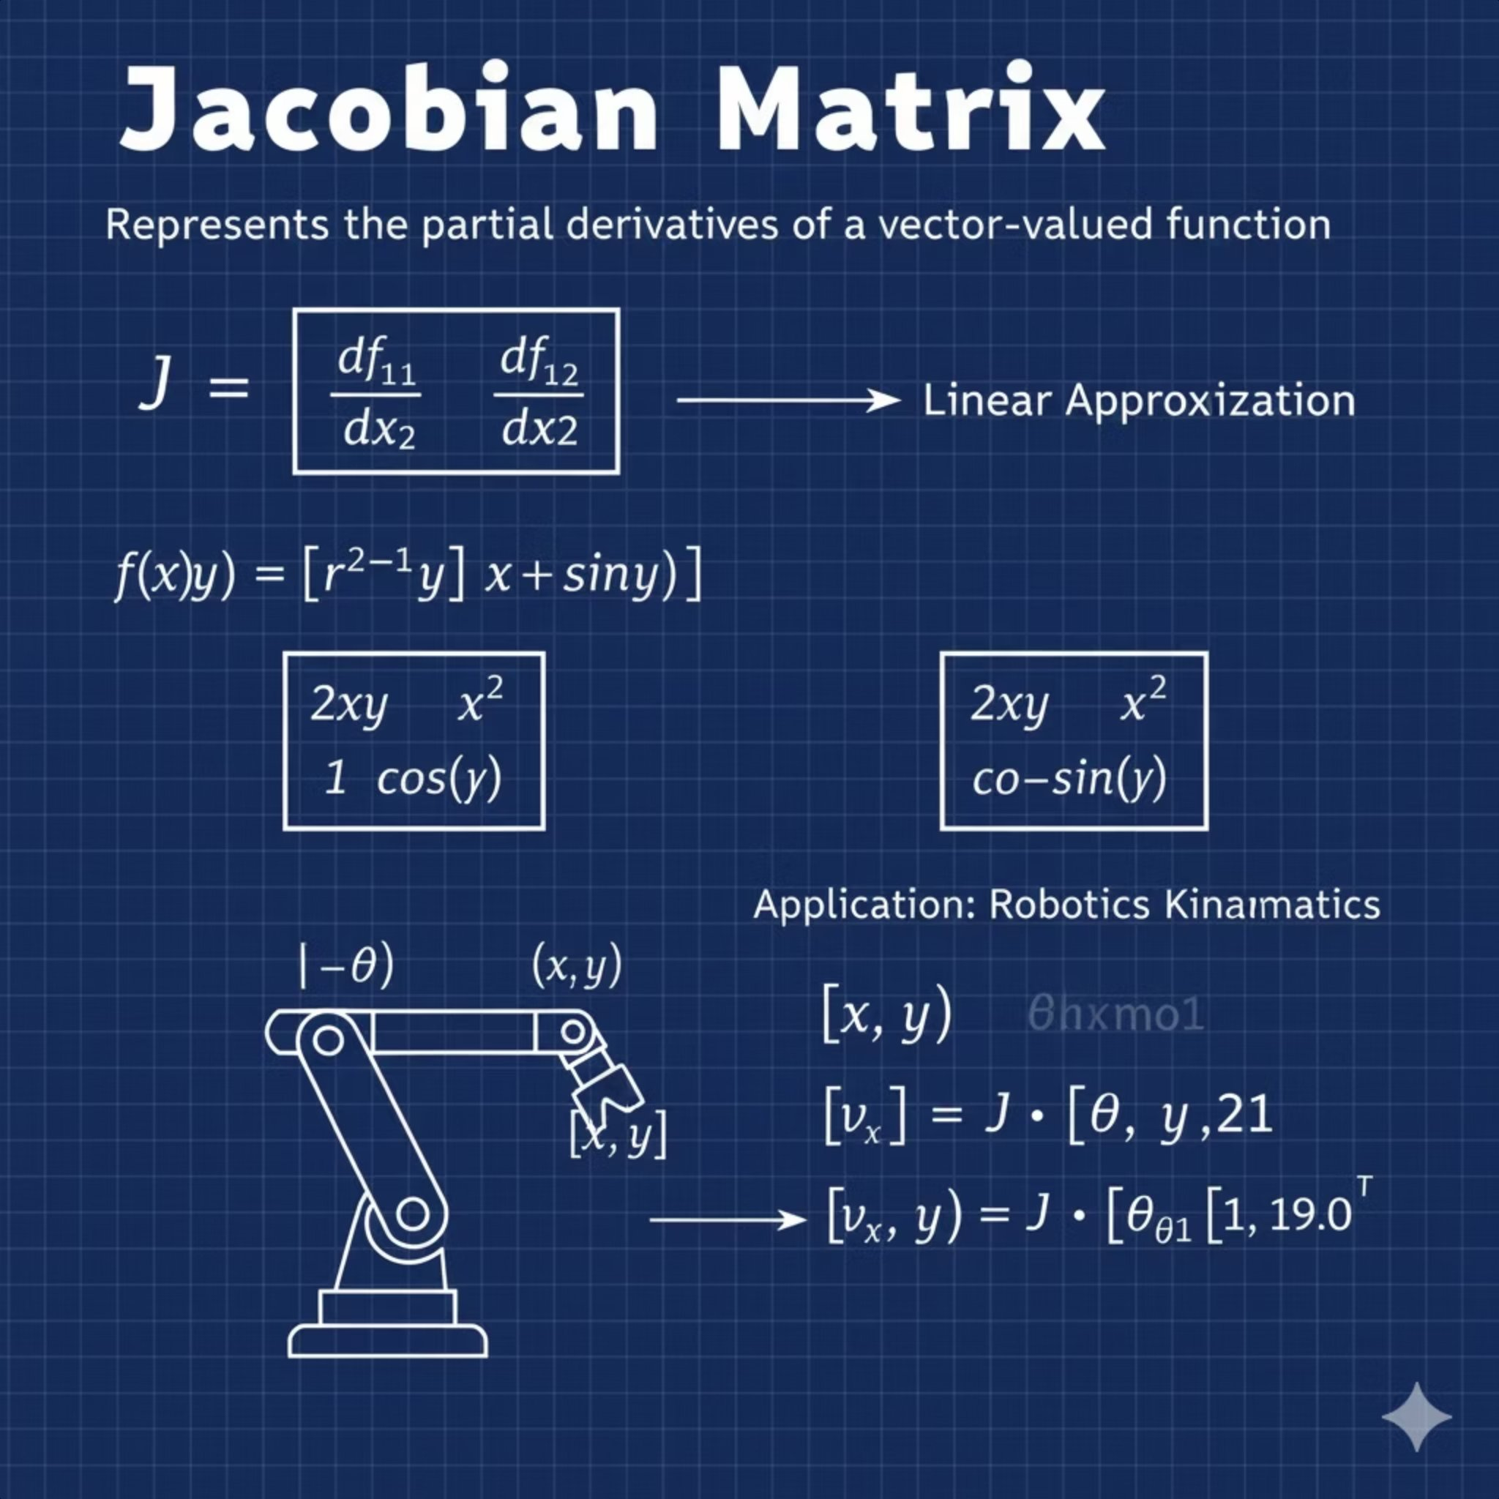
EKF-SLAM Approach
Helps Robot to estimate Robot Pose and Landmark Positions at the same time
Why EKF?
Robot motion is non-linear
Sensor models are non-linear
So, EKF approximates non-linear models using linearization.
How EKF works
Uses Jacobian matrices to linearize equations
Applies Kalman Filter equations on this approximation
Continuously updates estimates

Slide 13
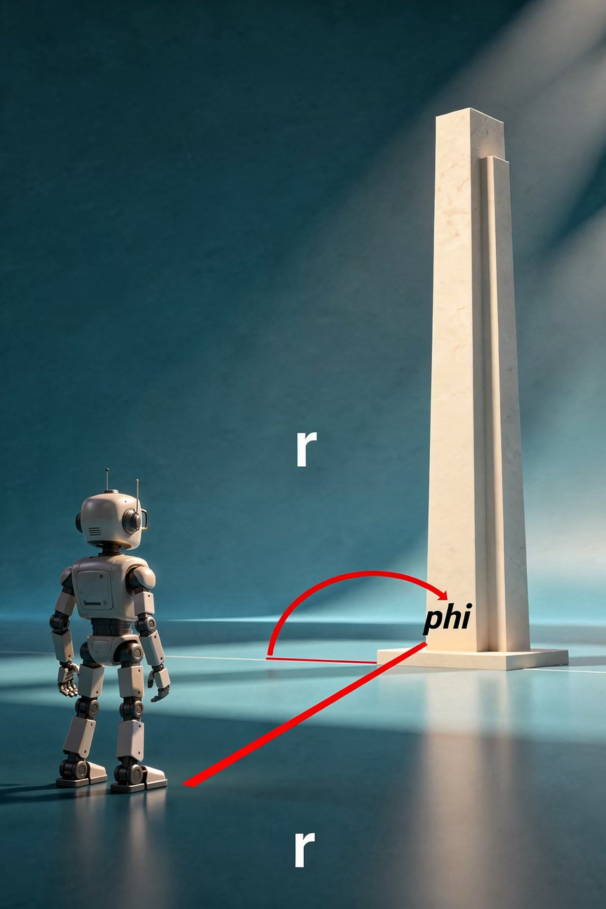
EKF-SLAM Components
State vector: robot pose + landmark positions
Prediction step: uses odometry
Update step: uses sensor measurements
Covariance matrix: represents uncertainty
Understanding the State Vector
Eg:
[x,
y,
θ,
Lx1,
Ly1,
Lx2,
Ly2,
.
.
LxN,
LyN]
Robot's Pose: Includes x, y, and θ coordinates.
Landmark Positions: Dynamically added as discovered.
Covariance Matrix: Represents confidence in the state.
Correlation: Learns relationships between landmarks.

Slide 14

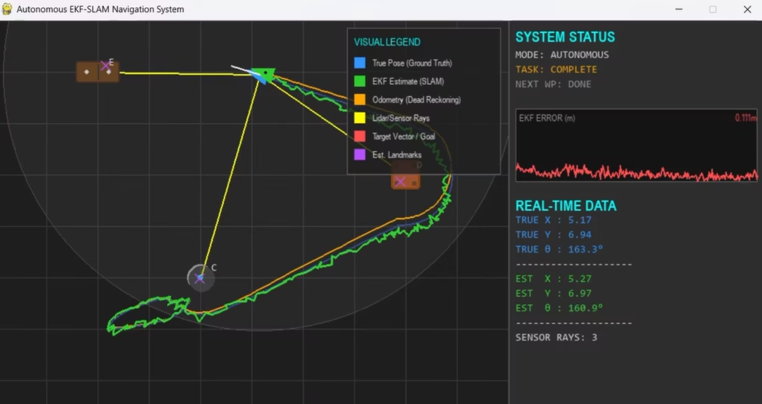
Simulation & Results
Simulation Setup
Implemented using Pygame,numpy,
Visualizes robot motion, landmarks, and paths

Slide 15

Simulation & Results
Simulation Setup
Results Observed
Implemented using Pygame,numpy,
Trajectory Comparison: EKF (Green) stays locked to Ground Truth (Blue), unlike Odometry (Orange) which drifts significantly.
Visualizes robot motion, landmarks, and paths
Error Analysis:
Odometry Mean Error: (High drift).
EKF Mean Error: (High accuracy).
Mapping: Successfully converged 5 landmarks to true coordinates with minimal variance.
EKF-SLAM provides better accuracy compared to odometry alone.

Slide 16
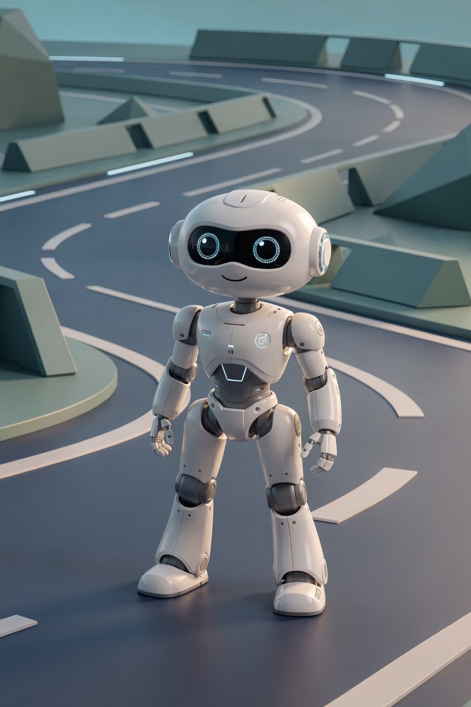
Conclusion & Future Work
Conclusion
Future Scope
Differential drive kinematics enable realistic robot motion
Loop Closure: Detecting when the robot returns to a previously visited room.
Odometry alone is insufficient due to drift
Hardware Implementation: Porting logic to a physical TurtleBot or ROS2 environment.
EKF-SLAM successfully improves localization and mapping
Visual SLAM: Replacing Lidar with camera-based feature extraction.
Autonomous navigation is achieved in a noisy environment

Slide 17


